Slide 1
DIGITAL PORTFOLIO
Name: M. Mathankumar
Register No: 24BCS119
NM ID: asbru001224bcs119
Department: Computer science
College: Govt arts college, Coimbatore -18

Slide 2
PROJECT TITLE: MATHANKUMAR DIGITAL PORTFOLIO

Slide 3
Agenda Topics Covered
Problem statement
Project overview
End users
Tools and technology
Portfolio design and layout
Features and functionality
Results and screen shot
Conclusion

Slide 4
PROBLEM STATEMENT
In today’s digital world, students and professionals need a platform to showcase their skills, achievements, and projects. However, traditional resumes are limited in representing practical skills, creativity, and hands-on work. A digital portfolio solves this gap by providing an interactive, accessible, and professional way to present one’s work.

Slide 5
PROJECT OVERVIEW
This project focuses on designing and developing a digital portfolio that highlights academic details, technical skills, certifications, and project work. The portfolio is structured to give a complete professional view of the student’s journey, making it useful for placements, internships, and higher studies.

Slide 6
WHO ARE THE END USERS
Recruiters and hiring managers.
College placement officers.
Faculty members evaluating projects.
Potential collaborators or peers.
Graduate schools for higher education admission.

Slide 7
TOOLS AND TECHNIQUES
Frontend: HTML, CSS, JavaScript
Backend (if applicable): Node.js / Python / PHP
Design Tools: Figma / Canva for layout design
Version Control: Git & GitHub for code management
IDE Used: VS Code

Slide 8
PORTFILO DESIGN AND LAYOUT
The portfolio follows a clean, responsive, and user-friendly layout.
Home Page: Introduction and personal details.
About Section: Educational background and skills.
Projects Section: Detailed descriptions with screenshots and GitHub links.
Certificates Section: Achievements and certifications.
Contact Section: Easy communication through email and links.

Slide 9
FEATURES AND FUNCTIONALITY
Responsive design for desktop and mobile devices.
Interactive navigation menu.
Direct links to GitHub and LinkedIn profiles.
Project showcase with descriptions and images.
Contact form for communication.
Downloadable resume option.

Slide 10
RESULTS
Successfully developed a working portfolio website.
Portfolio displays academic details, skills, and projects effectively.
Screenshots: (Insert snapshots of your Home page, Projects page, and Contact form here).

Slide 11
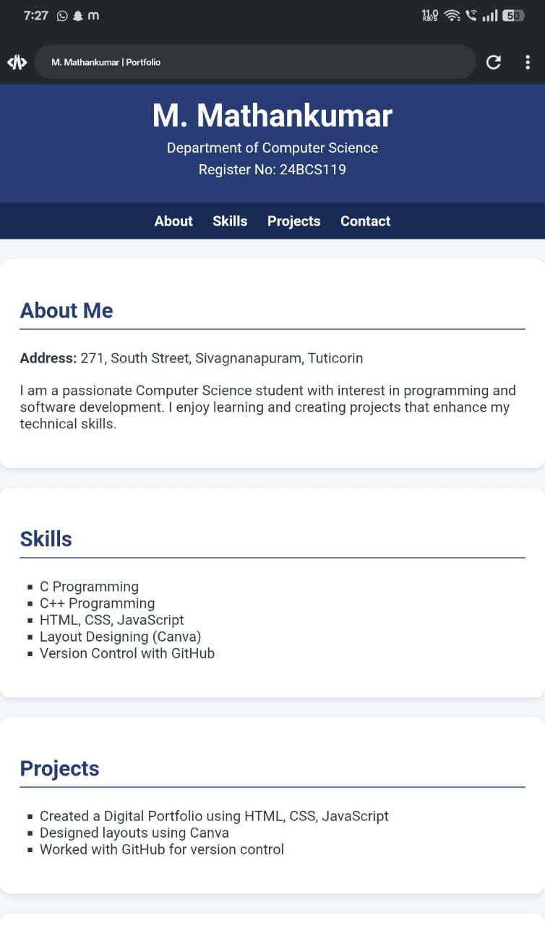
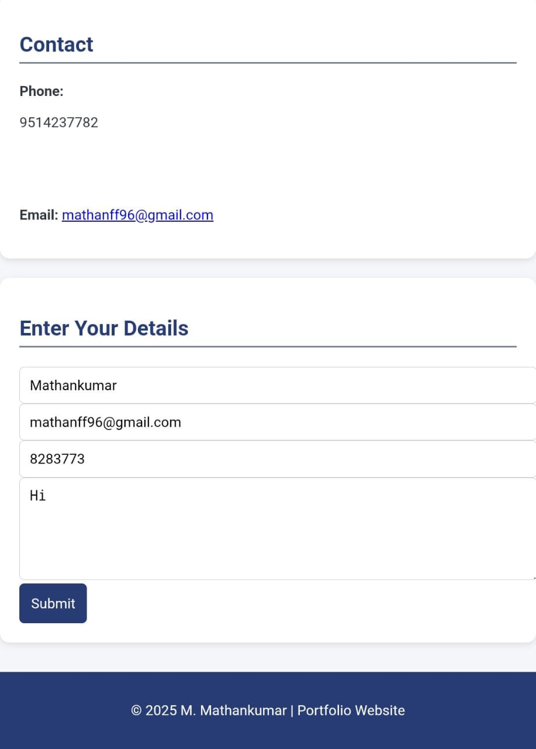
SCREEN SHOT

Slide 12
CONCLUSION
The project demonstrates how a digital portfolio can act as a powerful professional branding tool. It provides a comprehensive platform to showcase skills, projects, and achievements. Future enhancements may include blog integration, AI-based resume suggestions, and live project demos.

